Slide 1

Water Supply Network Optimization
Yinyu Ye, Mike Phulsuksombati, Guangjun Su
March, 2017

Slide 2
Agenda
Overview
Background
Water Supply Network Model
Mathematical Model
Pure flow problem
Convex Relaxation
Network Sparsification
Numerical Example

Slide 3
Background
Non-revenue Water
Non-revenue water (NRW)
The difference between the volume of water put into a water distribution system and the value that is billed to customers
Physical losses
Leakage from all parts of the system
Overflows at the utility’s storage tanks
Poor operations and maintenance

Slide 4
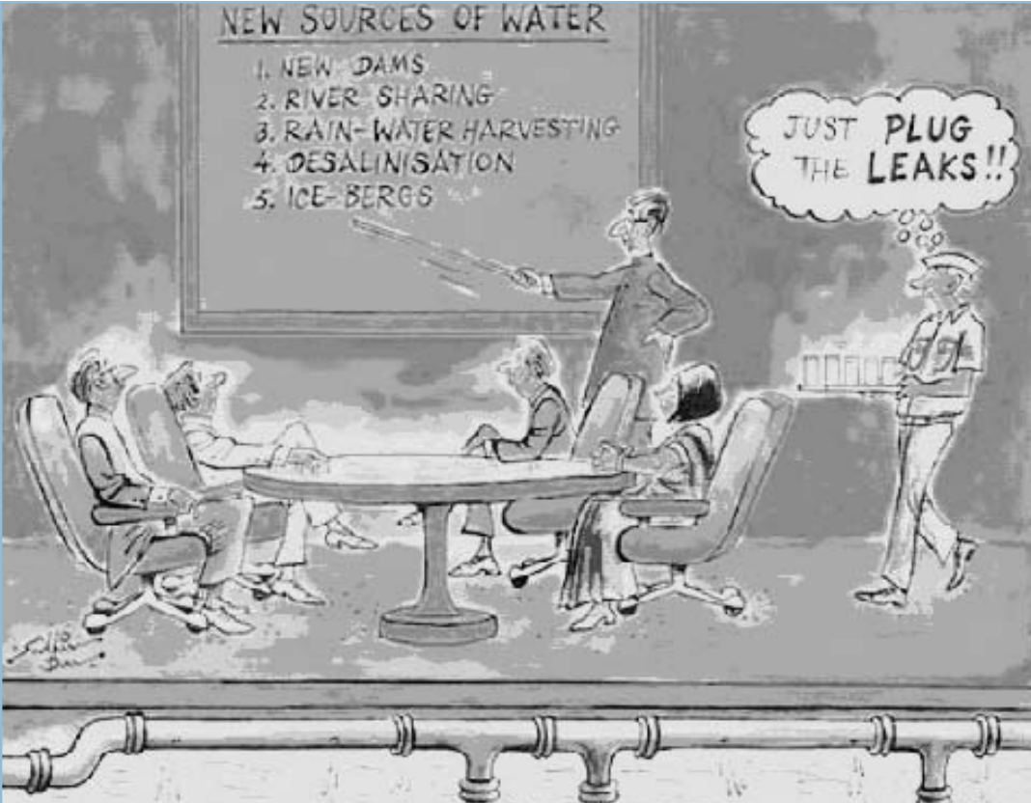
Background
Non-revenue Water

Slide 5
Background
How Much Water is Lost?
US$ 14 billion is lost every year by water utilities around the world…
 | Supplied Population (millions) | System input (l/capita/day) | Level of NRW (% of system input) | Volume (billion of m³/year)
Developed countries | 744.8 | 300 | 15 % | 9.8
Eurasia | 178.0 | 500 | 30 % | 6.8
Developing countries | 837.2 | 250 | 35 % | 16.1

Slide 6
Water Supply Network
The Technical Issues
Better Operative Planning?
Majority of leakage is due to unnecessarily high pressures and water flow in the network
Difficulties
Hourly demand forecast (at low demand vs. at peak demand)
Ensure that requested water is transported from the source to the consumers with necessary pressure and flow
Many related elements
Pumps
Valves
Tanks
Water sources
Consumers

Slide 7
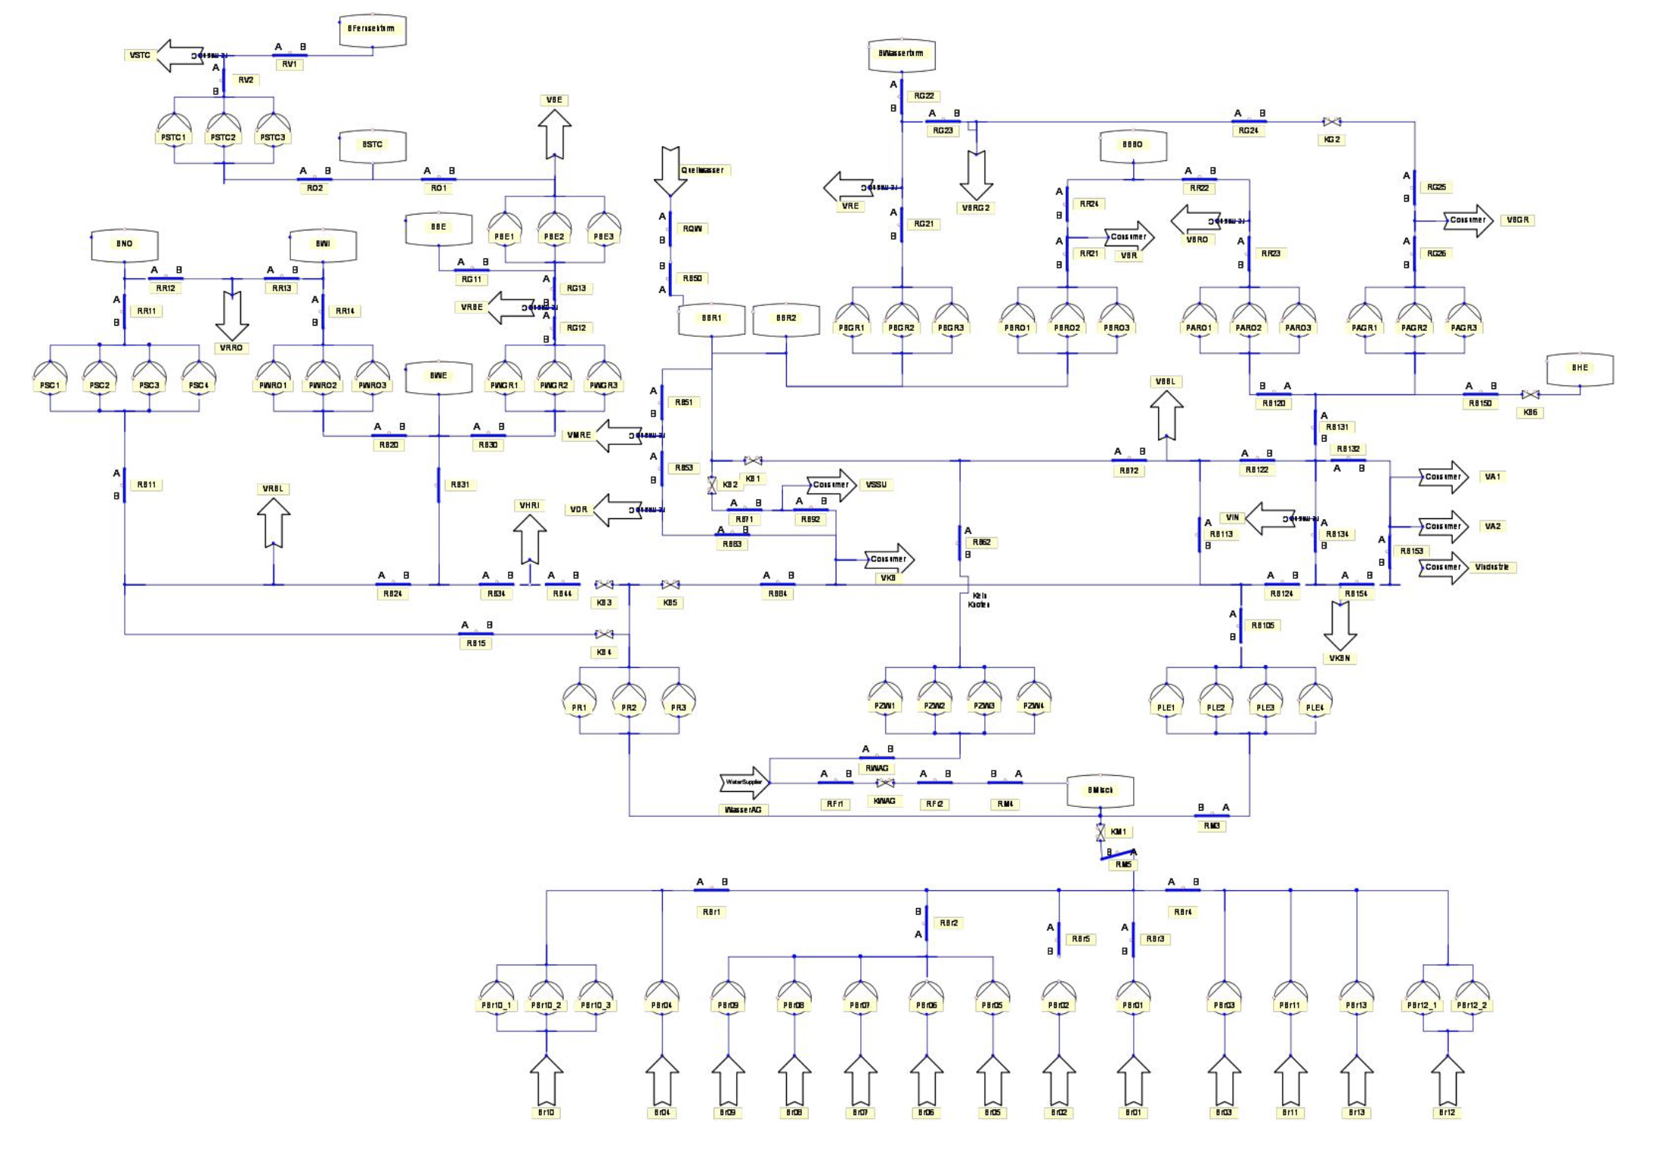
Water Supply Network Model
Elements in the Network
Tanks
Can act as both water sources and consumers
Turn open/close
Valves
Block the flow in the pipe
Turn on/off
Consumers
Have demands and pressure requirements
Pumps
Increase pressure at the outgoing end of the pipe
Turn on/off
Water sources
Supply water to the network

Slide 8
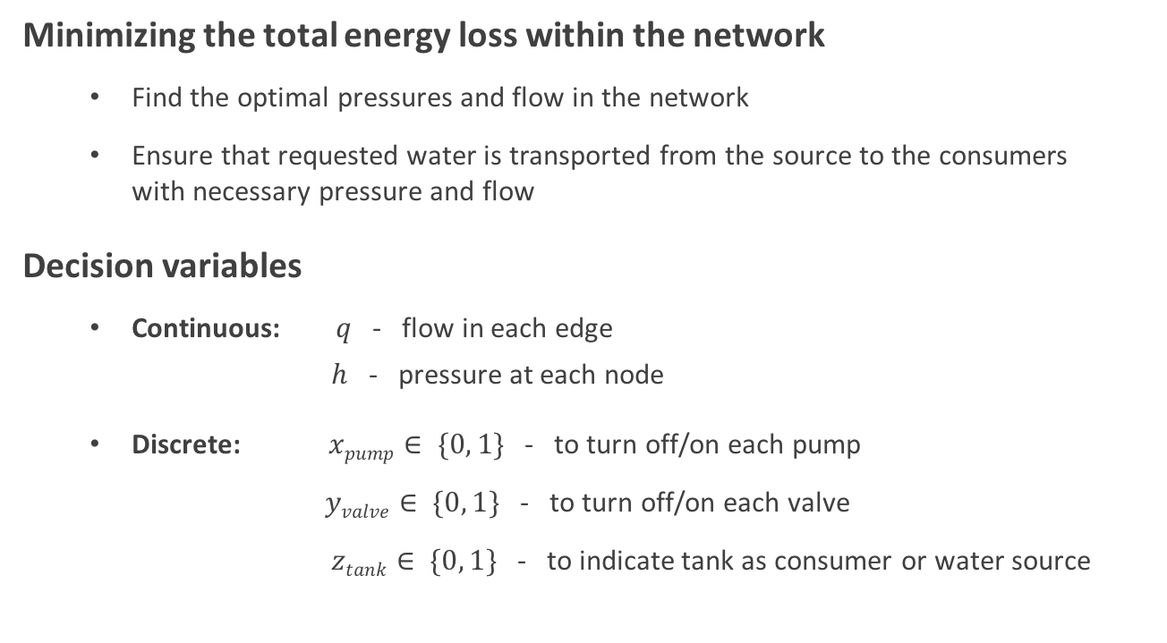
Water Supply Network Model
Objective and Decision variables
Minimizing the total energy loss within the network
Find the optimal pressures and flow in the network
Ensure that requested water is transported from the source to the consumers with necessary pressure and flow
Decision variables
Continuous: $q$ - flow in each edge
$h$ - pressure at each node
Discrete: $xpump∈ \{0, 1\}$ - to turn off/on each pump
$yvalve∈ \{0, 1\}$ - to turn off/on each valve
$ztank∈ \{0, 1\}$ - to indicate tank as consumer or water source

Slide 9
Water Supply Network Model
Complexities
The problem features
discrete and continuous decisions
nonconvex objective function
nonlinear constraints
Can be modeled as
nonconvex mixed-integer nonlinear program (MINLP) [Gleixner et al. 12]
accurate, but too complex for large problem
nonlinear program (NLP) [Burgschweiger et al. 04]
locally optimal solution

Slide 10
Water Supply Network Model
Main question
Can we model the problem as convex programming ?
Global optimality
Fast computation time

Slide 11



Our Convex Model
Overview
Water supply network is modeled as a directed graph with
Node: water source, consumer, junction
Edge: pipe segment
Overview
Predirection
- Find optimal route direction
Convex Relaxation
- Relax the objective and constraint
to be convex
Solution Recovery
- Recover the discrete variable
- Which pumps/values to
turn off/on ?

Slide 12
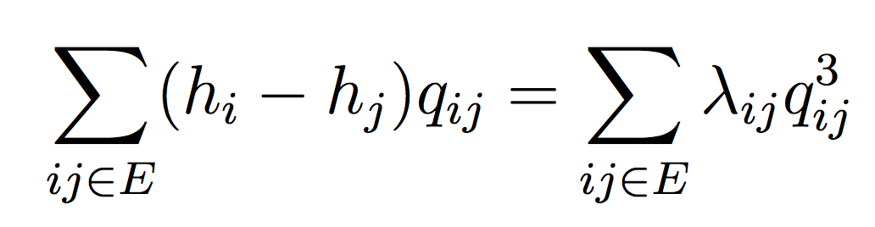
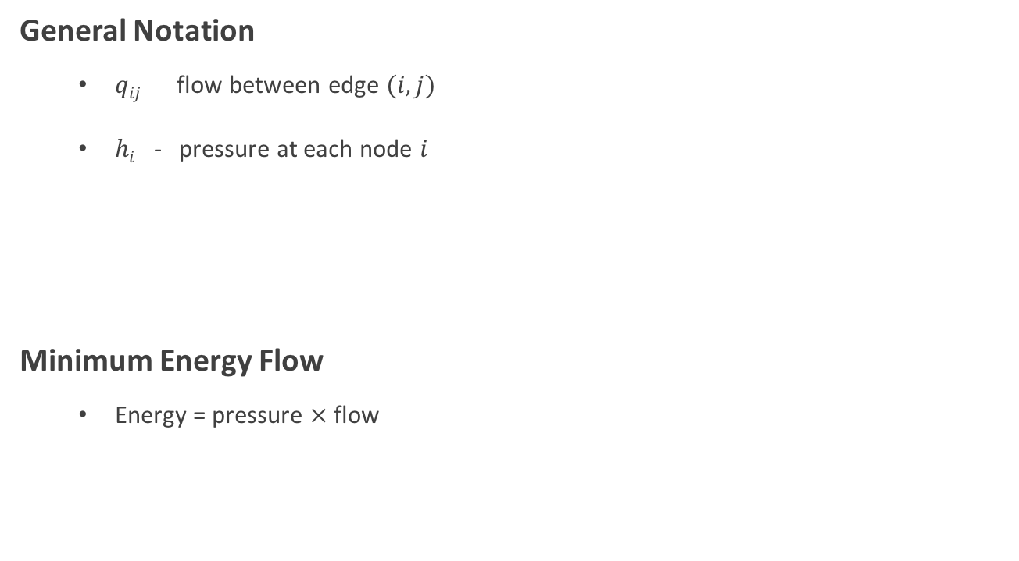
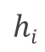
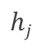
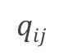
Mathematical Model
Objective Function
General Notation
$qij$ flow between edge $(i,j)$
$hi$ - pressure at each node $i$
Minimum Energy Flow
Energy = pressure $×$ flow
$$hi$$
$$qij$$
$$hj$$

Slide 13
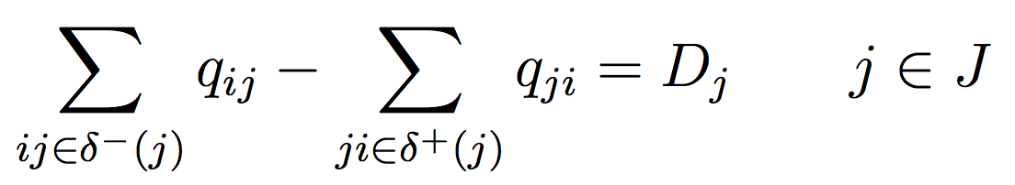
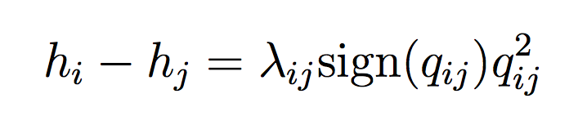
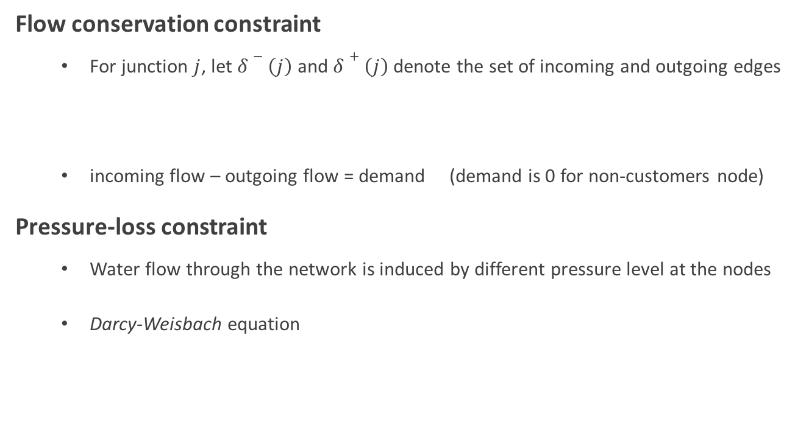
Mathematical Model
Constraints
Flow conservation constraint
For junction $j$, let $δ−\left(j\right)$ and $δ+\left(j\right)$ denote the set of incoming and outgoing edges
incoming flow – outgoing flow = demand (demand is 0 for non-customers node)
Pressure-loss constraint
Water flow through the network is induced by different pressure level at the nodes
Darcy-Weisbach equation
where $λij$ is the loss coefficient due to friction

Slide 14
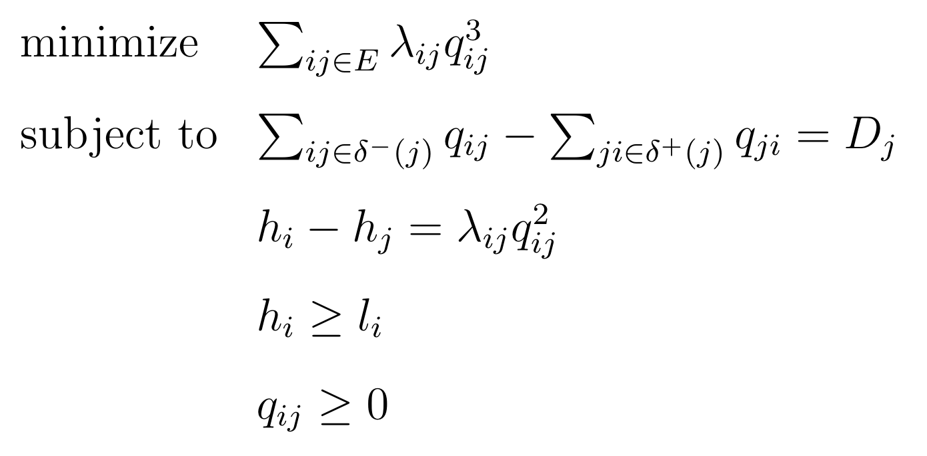
Mathematical Model
Model Summary
Minimum Energy Flow
The objective is convex, but the pressure-loss constraint is nonconvex.
Therefore, the minimum energy flow problem is nonconvex.

Slide 15
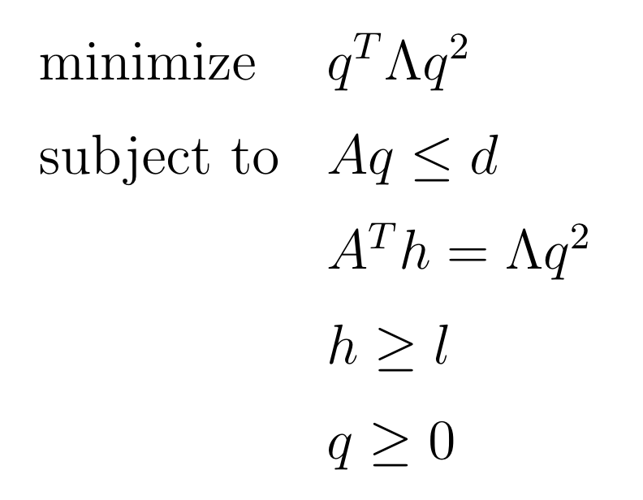
Mathematical Model
Model Summary (Matrix version)
Minimum Energy Flow
The objective is convex, but the pressure-loss constraint is nonconvex.
Therefore, the minimum energy flow problem is nonconvex

Slide 16
Our Convex Model
Overview
Overview
Predirection
- Find optimal route direction
Convex Relaxation
Solution Recovery

Slide 17
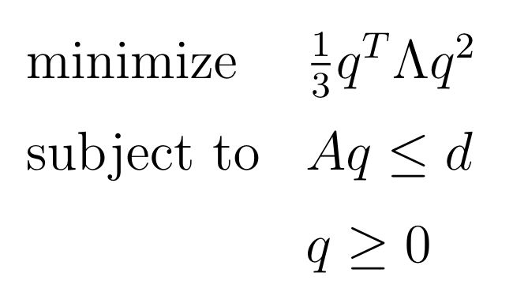
Predirection
Find the optimal flow direction
Pure Flow Model
Solve the pure flow problem (ignoring all pressure-related constraints) on the bidirectional graph
Determine the direction of the flow based on the solution of pure flow problem
Note that pressure-loss constraint is satisfied due to the optimality condition of our objective. Moreover, the problem is convex.

Slide 18
Predirection
Example
Solve the pure flow problem on bidirectional graph

Slide 19
Predirection
Example
Determine the direction of the flow

Slide 20
Our Convex Model
Overview
Overview
Predirection
Convex Relaxation
- Relax the objective and constraint
to be convex
Solution Recovery

Slide 21
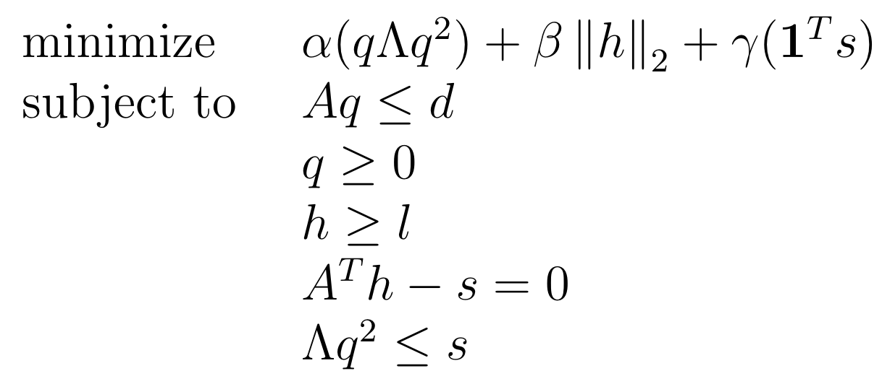
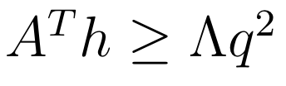
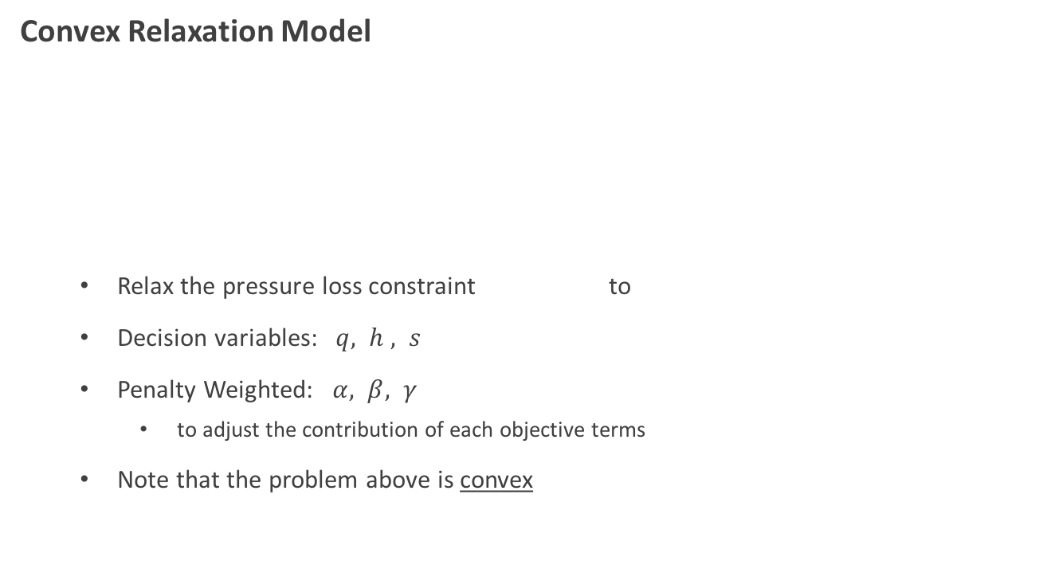
Convex Relaxation
Relax the pressure-loss constraint
Convex Relaxation Model
Relax the pressure loss constraint to
Decision variables: $q, h , s$
Penalty Weighted: $α, β, γ$
to adjust the contribution of each objective terms
Note that the problem above is convex

Slide 22
Convex Relaxation
Example
Solve the relaxation problem to get flow and pressure

Slide 23
Convex Relaxation
Example
Some edge will satisfy and some edge will have
Clearly,
for this edge
This actually gives us some useful information about the network!

Slide 24
Our Convex Model
Overview
Overview
Predirection
Convex Relaxation
Solution Recovery
- Recover the discrete variable
- Which pumps/values to
turn off/on ?

Slide 25
Solution Recovery
Example
We can recover the discrete decision variable from edges that are not satisfy
If this edge is a valve, the valve should be turn off (0)

Slide 26
Solution Recovery
Example
We can recover the discrete decision variable from edges that are not satisfy
This edge does not satisfy
(require some calculation)
If this edge is a pump, the pump should be turn on (1) to raise the end node pressure to 1265

Slide 27
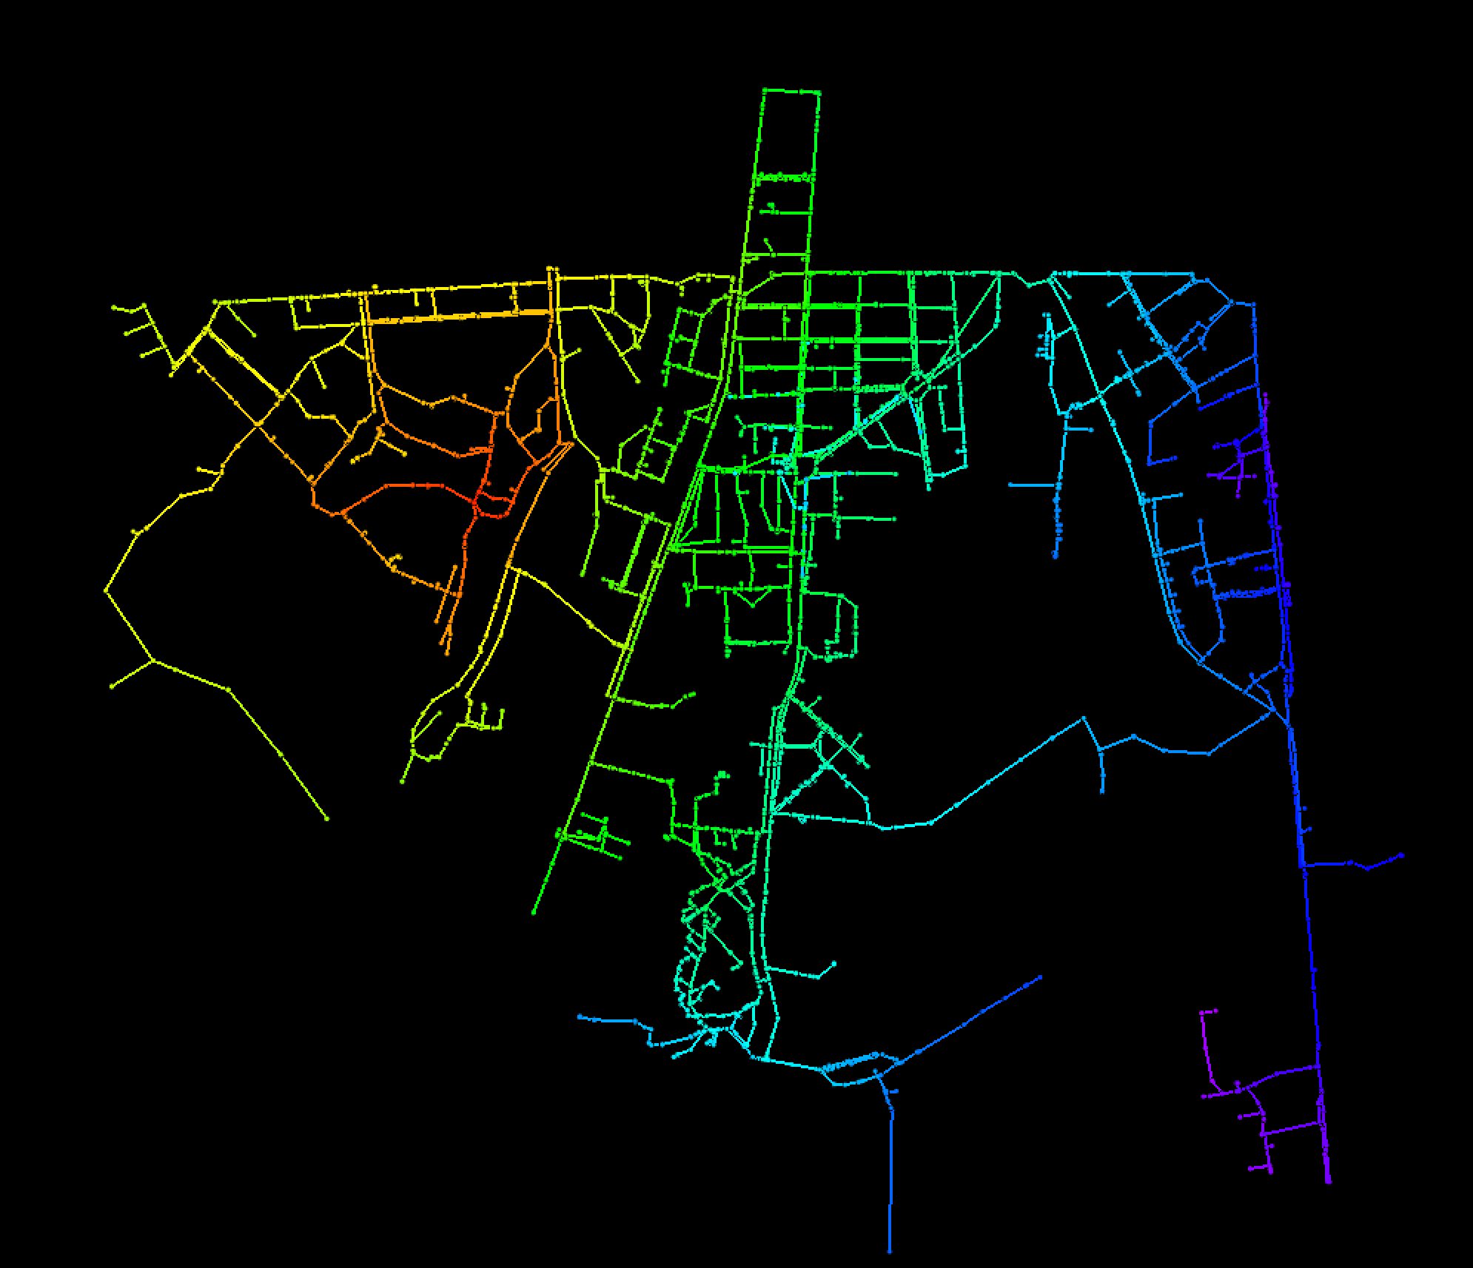
Numerical Example
Real Municipal Water Supply Network
Nodes
Reservoir | 20
Tank | 1
Junction | 7,099
Consumer | 846
Edges
Pipes | 6,074
Valves | 1961
Pumps | 24

Slide 28
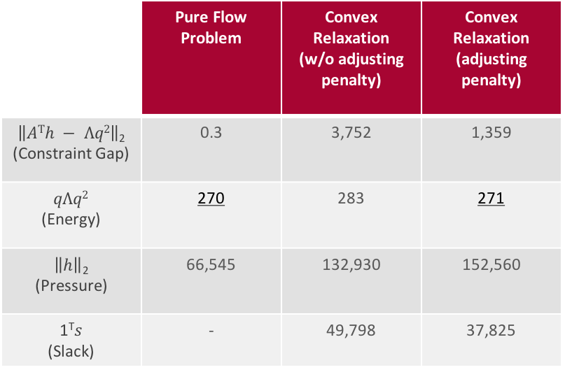
Numerical Example
Result
The relaxation model get almost the same energy as the pure flow model
We pay tradeoff the increase in the objective to satisfy the minimum pressure constraint (which pure flow problem does not consider)
 | Pure Flow Problem | Convex Relaxation (w/o adjusting penalty) | Convex Relaxation (adjusting penalty)
$\left\|ATh − Λq2\right\|$₂ (Constraint Gap) | 0.3 | 3,752 | 1,359
$$qΛq2$$ (Energy) | 270 | 283 | 271
$\left\|h\right\|$₂ (Pressure) | 66,545 | 132,930 | 152,560
1^{T}$s$ (Slack) | - | 49,798 | 37,825

Slide 29
Numerical Example
How fast can we solve our model?
Since all problems is convex, we can solve them really fast!
Using convex program solver such as MOSEK, SeDuMi
To put this into perspective, MINLP formulation solve 88 nodes in 18.2 s (on average)
Recover the discrete variables can be done in linear time
 | Small Problem (272 nodes 276 edges) | Large Problem (7876 nodes 8059 edges)
MOSEK | 1.63 s | 7.07 s
SeDuMi | 0.74 s | 13.6 s

Slide 30
Our Contribution
Convex Relaxation Model for Water Supply Network Optimization
Pure flow problem
Convex Relaxation
Solution Recovery
Thank you for listening!

